Slide 1
Announcing Universal Apps
Notes:
With the release of Windows Phone 8.1, it is now possible to use the Windows Runtime to build apps that can target each form factor in the family of Windows devices. Using the universal Windows app project templates, you can now create one app where your business logic can be surfaced up through a user experience relevant to the device. This unified approach to app development means that your app has the potential to reach not just Windows phones and tablets, but Windows laptops and workstations as well.
This enables you as a developer to write less code and target more platforms!

Slide 2
Agenda
Overview of universal apps
Visual Studio Support
Concepts
Code Reuse
Store Support
Q&A
Notes:
In this presentation we will introduce Universal Apps and show how Visual Studio 2013 allows you to create and work with these project types. We will then look at the mechanisms available to help achieve sharing of your UI elements and code components. This will cover UI API specifics and a brief inclusion of Portable Class Libraries. We will conclude with an overview of how the Windows Store has updated to support this type of app model.

Slide 3
Prerequisites
Visual Studio 2013
Visual Studio 2013 Update 2
Get the express edition of VS 2013 w/Update 2 @ http://go.microsoft.com/fwlink/p/?LinkId=389848
Notes:
A number of improvements are included in Visual Studio 2013 Update 2 to support universal Windows app development. Universal Windows app templates make it even easier to reuse code between Windows Store apps and Windows Phone 8.1 apps. The update includes new additions to Windows platform diagnostic tools that analyze CPU, UI, Energy and Memory for XAML & HTML apps for both Windows Store & Phone developers.

Slide 4
Universal apps
Universal apps enable building applications on the converged Windows 8.1 and Windows Phone 8.1 platforms
Supported for C#, C++ and JavaScript
Create universal apps using project templates, migrating Windows 8.1 / Windows Phone 8.1 apps
Notes:
In Windows Phone 8, you basically had two choices when you wanted to do an app: Either use C#/VB with .NET and XAML or write a DirectX C++ app. You could also combine the two. With the new support for the Windows Runtime application model you can also write native apps in C++/XAML as well as native apps in HTML/Javascript. Furthermore, in all these languages, you can write universal apps which is a special type of solution to develop for both Windows 8.1 and Windows Phone 8.1 as efficiently as possible.

Slide 5
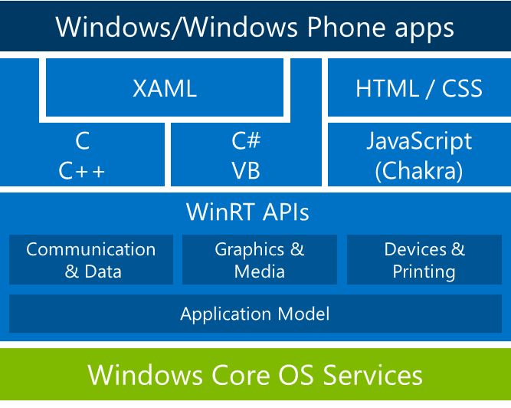
A common, familiar programming model for universal Windows apps
Notes:
The key component that makes Universal apps possible is the WinRT API which has always been in used for Windows 8.X apps but is now the foundation for Windows Phone 8.1. Thus, going from a Windows store app to a universal app is essentially the same code as there are no major API changes for Windows store apps. The big changes are for Windows phone apps which now use more of the Windows runtime rather than Silverlight.
Notice that the diagram include HTML / Javascipt for both Windows Phone and Windows 8. The ability to code Windows Phone 8.1 apps in JavaScript (really HTML/JavaScript/CSS) is new to Windows Phone 8.1 and mirrors how this works in Windows 8.x.
This means that everything you’ve learned from writing Windows Store apps now applies to writing phone apps as well, including the actual code. In addition to the execution model, the application model is also identical between the platforms. This means that you could share your app.xaml between the platforms if you would like to.

Slide 6
Shared projects
Allow sharing source between converged apps
Don’t have any binary output
Supports all item types
Code files .cs, .js, .cpp, .h
XAML
Images .png, .jpg…
RESW
XML etc…
Notes:
Thanks to the universal apps, we can now share much more than PCLs between applications targeting different platforms.
In Visual Studio, a universal solution is composed of at least 3 projects : one for Windows Store, one for Windows Phone and another one for the shared components.
In the shared project, you don’t share binaries (like in PCLs) but files such as resources, images, xml, XAML, code, … which will then be used in each platform-specific project.

Slide 7
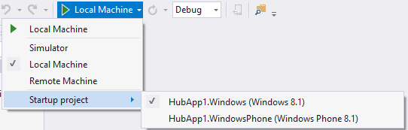
Switching startup projects
Quick and easy way to change startup projects using debug target dropdown
Supported for all Store platforms
Enabled if you have more than one application project in the solution
Notes:
Creating a new Visual Studio solution using the shared project template will produce a Visual Studio solution configuration that includes a shared project space where you can define the code to share between an app targeted for tablet & PC and another targeted for phone. It will also establish separate projects for elements of the app that are unique to either.
Changing the startup project allows you to build and deploy your code on the selected platform.

Slide 8
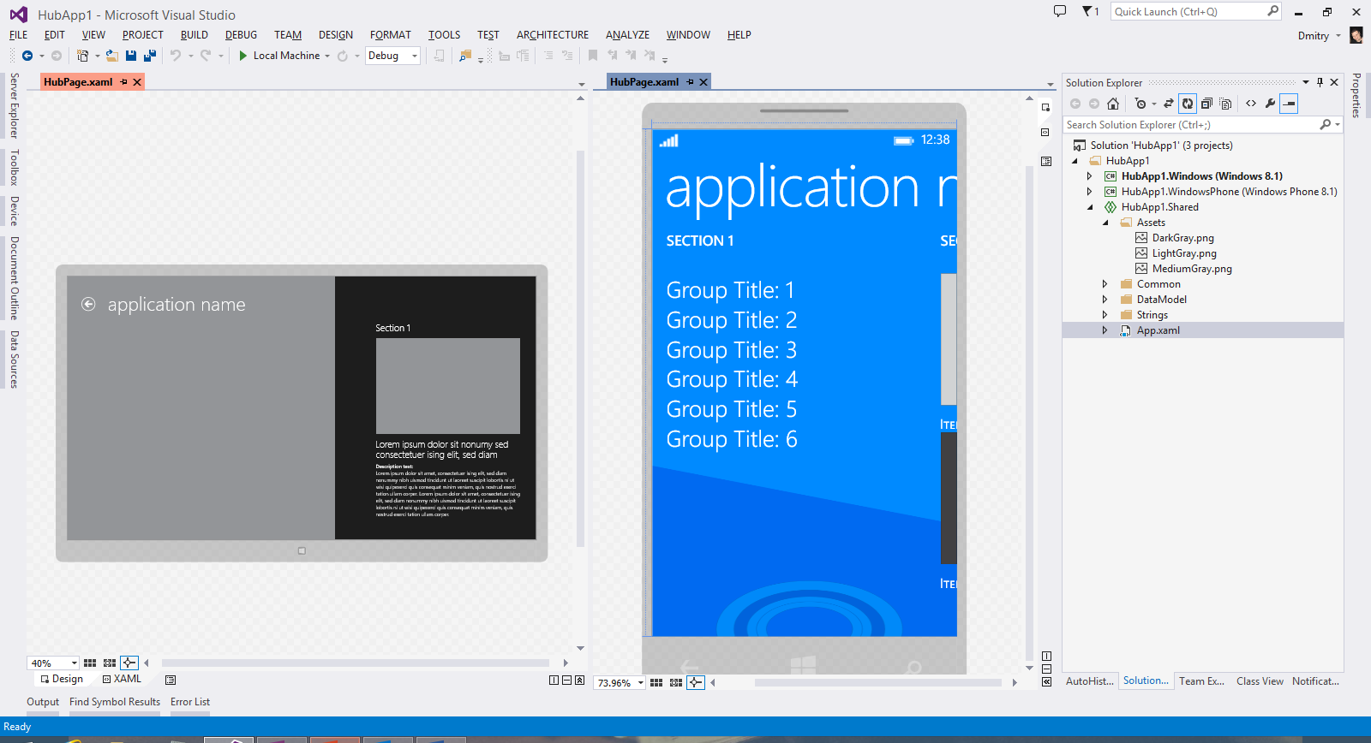
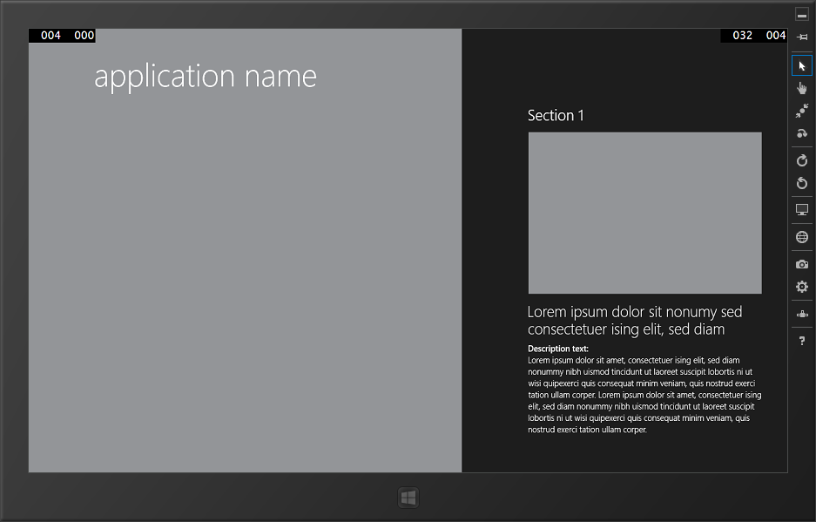
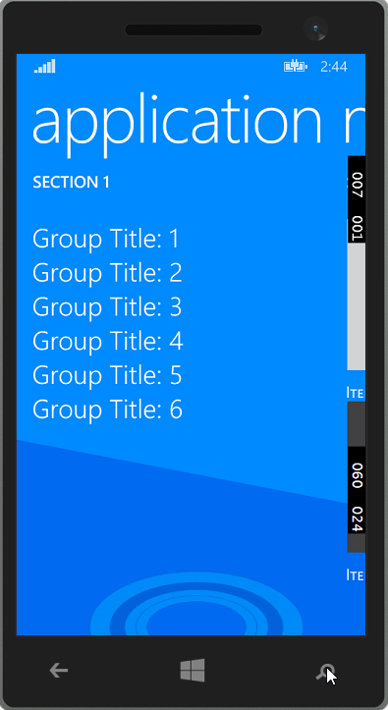
Share your XAML UI!
Notes:
The majority of the UI APIs are now common between Windows Store 8.1 and Windows Phone 8.1 (most of the differences are about Automation and picker controls specificities).
Common API doesn’t mean same UI user experience and most controls will look and behave differently according to the Platform. Some of them are quite similar, some other are very different

Slide 9

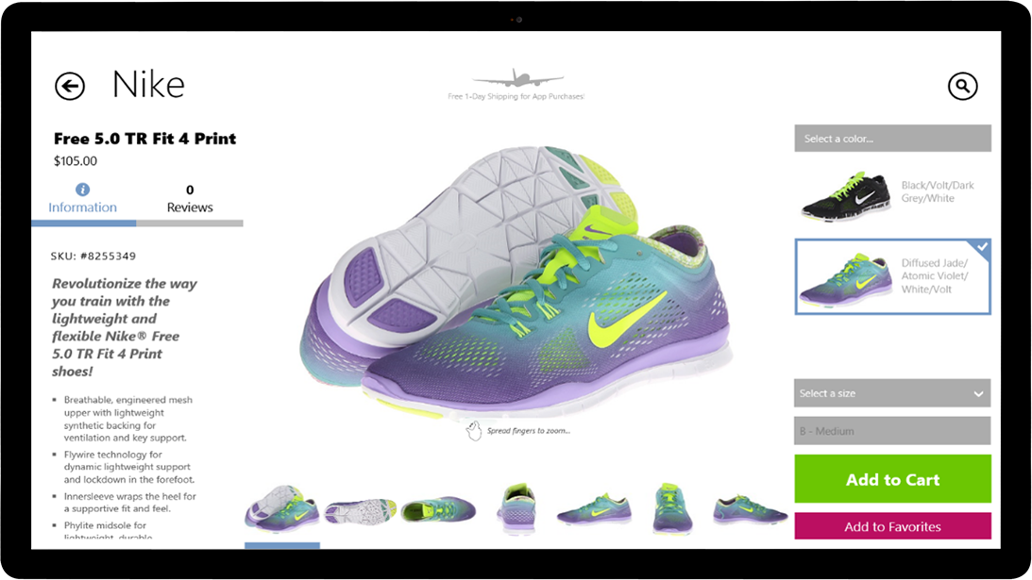
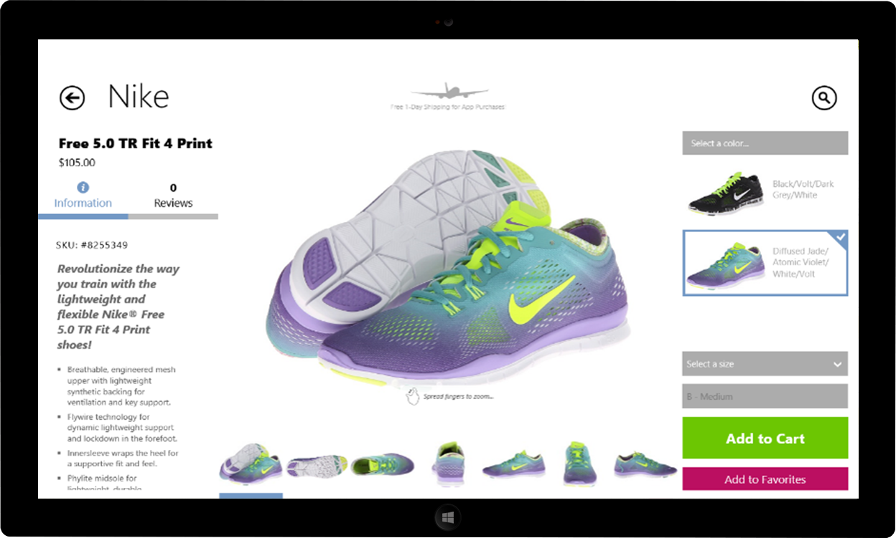
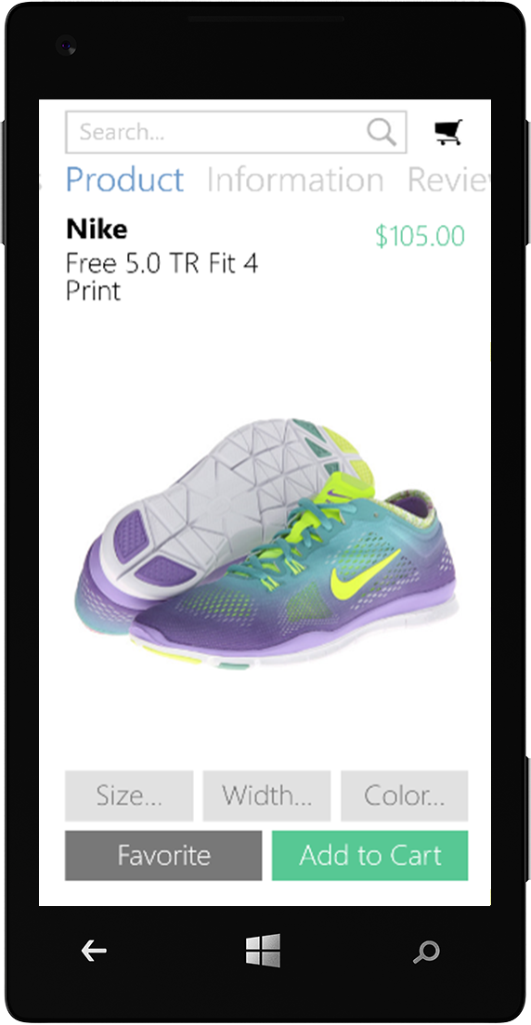
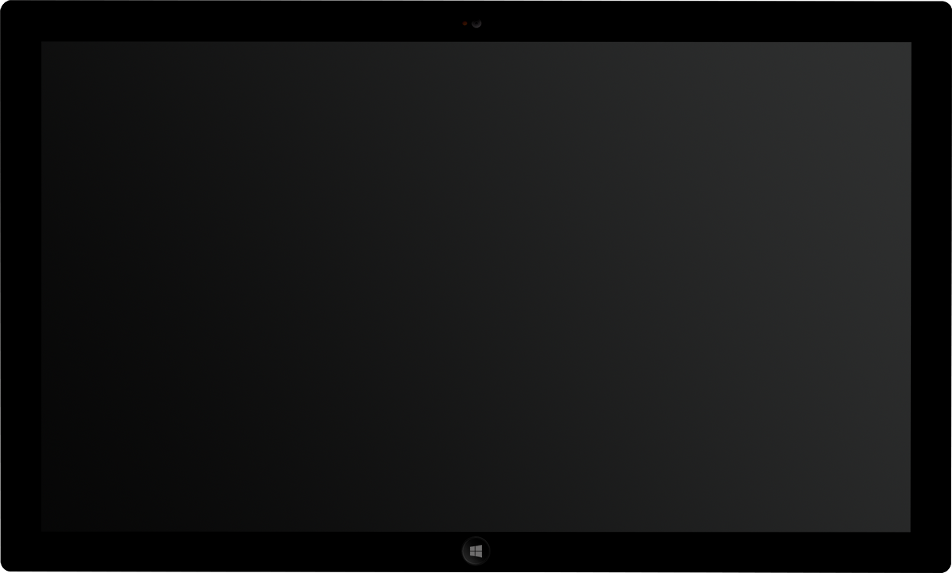
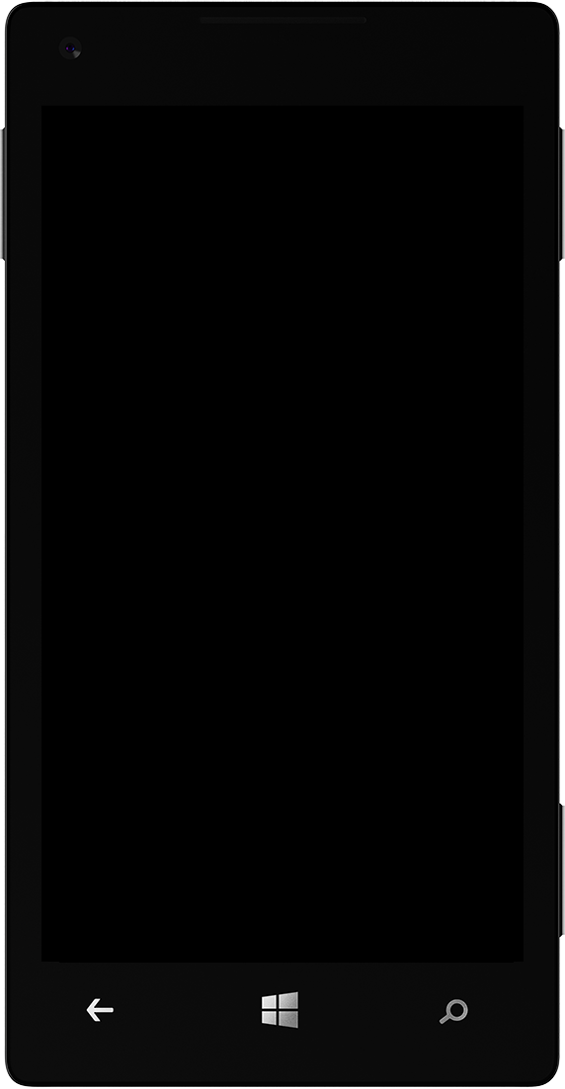
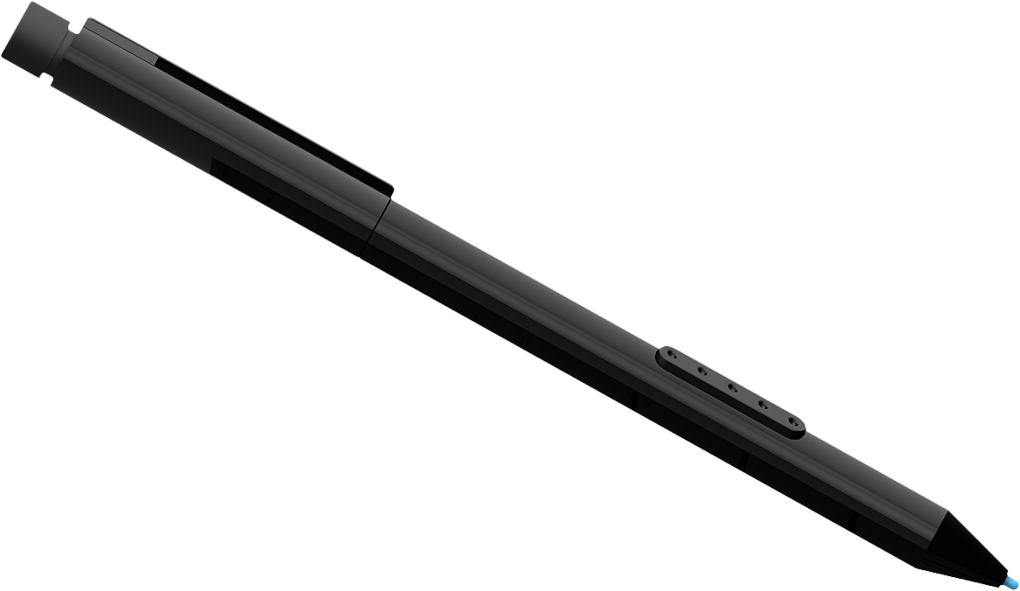
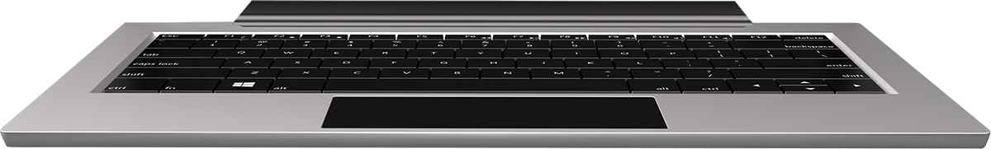
You can tailor the design to each device
Notes:
Although encouraged where possible, you are not required to share your XAML 1:1 across platforms. You can create device specific XAML or employ Visual States to render your XAML in the most appropriate way. This allows you to reuse code while maintaining an optimal user experience.

Slide 10
What is Common?
API Same
API Same, tailored behavior
Device-specific APIs
Notes:
Although UI sharing is now possible, behavior and appearance is not always the same depending on the device. We will go over controls that have no differences, those with similar APIs but behavioral differences, and those that are specific to the device.

Slide 11
‘Primitives’ - same
Layout: Panel, StackPanel, Grid, Border
Buttons, Slider, ToggleSwitch, CheckBox, RadioButton, ProgressBar
TextBox/TextBlock
Shapes/Path
Notes:
These control use the same API and exhibit the same appearance and behavior across platforms.

Slide 12
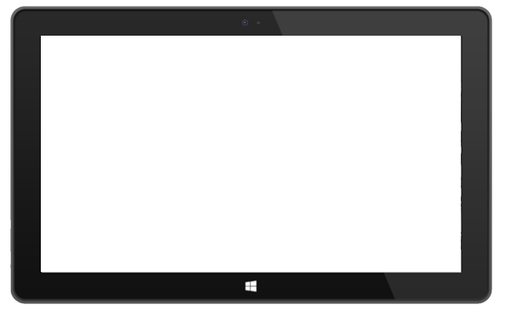
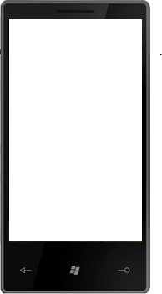
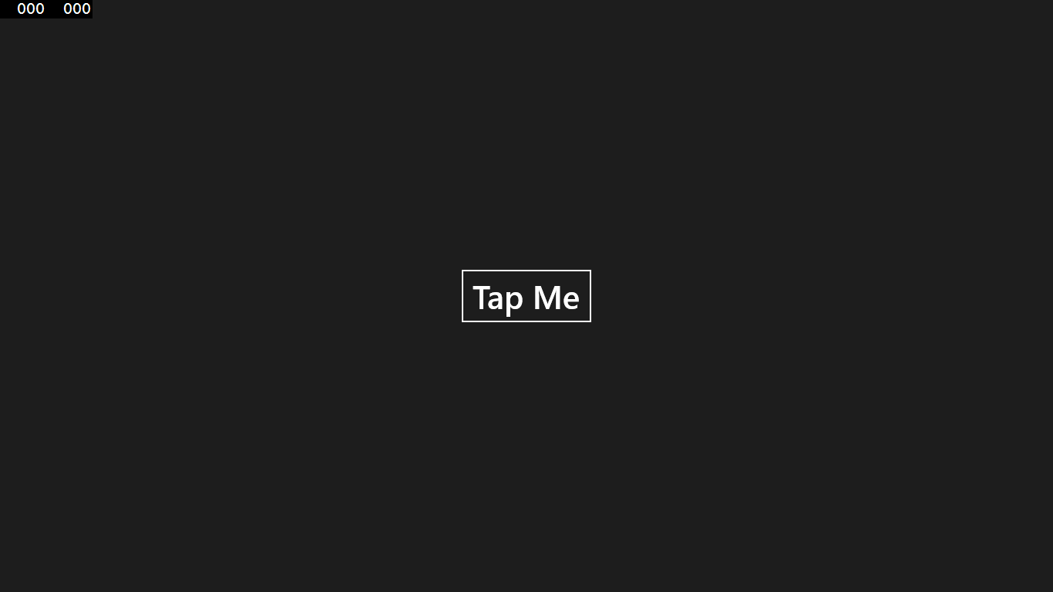
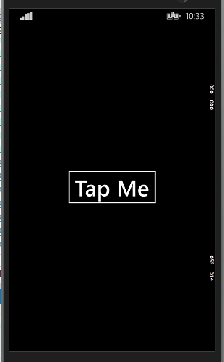
Notes:
A button is a button is a button, the same goes for the other primitives listed on the previous slide.
What this means is you can expect these controls to look and behave exactly the same across platforms.

Slide 13
‘Primitives’ – same API, tailored behavior
Hub
AppBar/CommandBar
Date/Time Pickers and List Pickers
ListView
Multi-select; containers, swipe selection
Flyouts
Media
Ads SDK*
Notes:
These controls use a similar API, meaning they can be used in a Shared XAML file without issue.
However, they have different behavior and possibly appearance, per device.
For example, the Hub control will behave like a Panorama control on Windows Phone but similar to a GridView on Windows 8.
*The Ads SDK have a similar API but the namespaces are different across platforms.

Slide 14
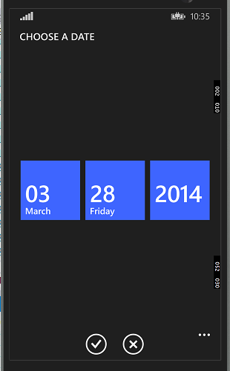
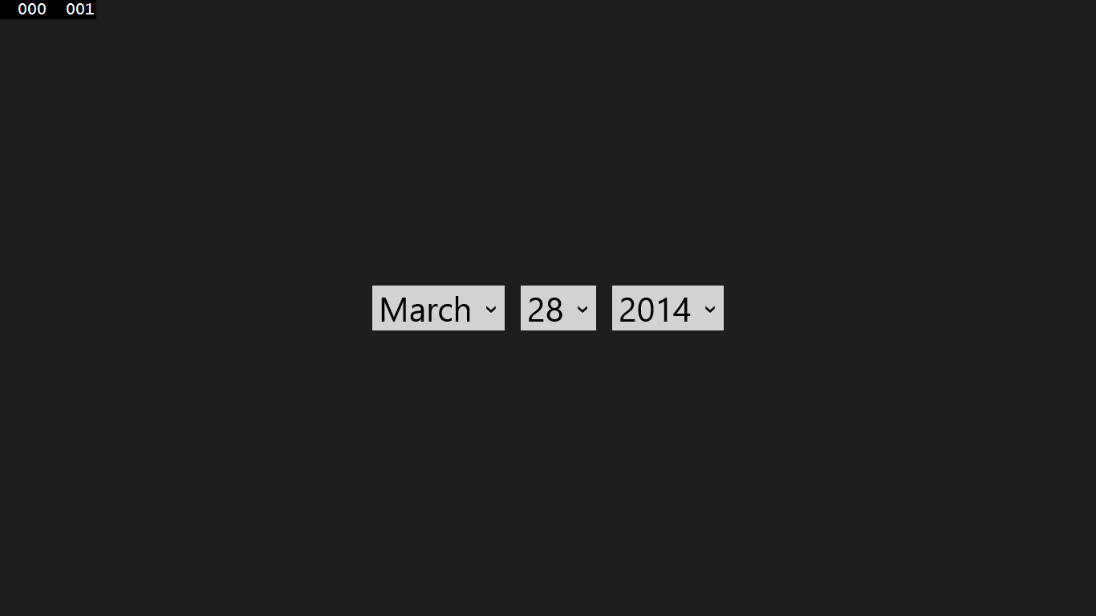
Notes:
Example of the Date Picker control on Windows 8 and Windows Phone.
Although the API for these controls is the same, the appearance and behavior are specific to the device.

Slide 15
Device-specific APIs
Windows
SearchBox
SettingsFlyout
Windows Phone
Pivot
AutoSuggestBox
ContentDialog
Maps
System Chrome
Progress area, in-call UI
Notes:
These control are platform specific. They can be used in a Shared project, but you may get a build error when building for a platform which does not support the control. This can be mitigated by using #if statements.

Slide 16
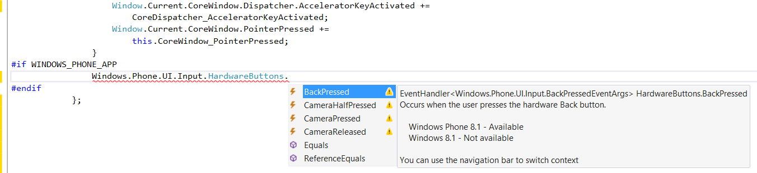
Code editing experience
Intellisense warnings for platform specific APIs
Switch project context using navbar
Notes:
When you're writing code in the Shared project, the Visual Studio code editor uses a context that targets one platform or the other. In C#, the Intellisense that you see as you write code is specific to the context of the code editor - that is, specific to Windows or to Windows Phone 8.
If you use an API in shared code that’s not supported on both platforms, an error message will identify this API when you build the project. You can confirm that you’re using cross-platform APIs, however, without building the project. Switch the editor context in the drop-down list to the other platform to see squiggly lines under APIs that are not supported on that platform. Then isolate those APIs by using the #ifdef directive.

Slide 17
Use conditional constants
C#: WINDOWS_APP and WINDOWS_PHONE_APP
#if WINDOWS_PHONE_APP
Windows.Phone.UI.Input.HardwareButtons.BackPressed += this.HardwareButtons_BackPressed;
#endif
C++: WINAPI_FAMILY_PC_APP and WINAPI_FAMILY_PHONE_APP
#if WINAPI_FAMILY==WINAPI_FAMILY_PHONE_APP
_backPressedEventToken = HardwareButtons::BackPressed +=
ref new EventHandler<BackPressedEventArgs^>(this,
&NavigationHelper::HardwareButton_BackPressed);
#endif
Notes:
As you share files and not binaries, you can also use pre-compilation directives in you C# code in the shared project. This can be a good alternative to avoid creating specific code files in the Platform projects, especially when the specificities are very small.

Slide 18






Portable Class Libraries Sharing one binary between projects I compile just once and know it works on all platforms
Code reuse options for universal apps
call WinRT APIs include code and .xaml files
Shared Projects
Sharing source code between projects
I can easily include platform-specific code under #if or partial classes
New!
Improved!
Notes:
Shared projects can share source code which may include device specific #IF statements for platform differences. Think of this as code sharing at the source level. All of this is achieved through file linking (i.e. a file is located in one place on disk and accessible during the build process of your platform specific projects).
PCLs can be consumed within the platform specific projects and are guaranteed to execute on the frameworks they target. They have been expanded to support Xamarin IOS and Xamarin Android projects as well as Windows Phone 8.1

Slide 19
New shared features across Windows Phone and Windows Dev Center
App Linking
App Name Reservation
Unified Registration
Consolidated Pricing
Notes:
Unification is not just occurring in the development environment, it has also expanded into the Windows marketplace and development center. Let’s talk about some of these features.

Slide 20
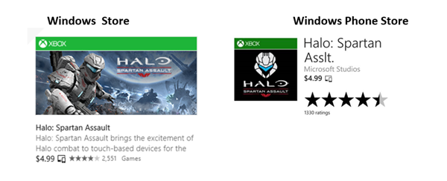
Linking Windows Store and Windows Phone apps to create a universal Windows app
Notes:
Linking provides a ‘get once and download for all compatible Windows devices’ customer experience, which we expect to increase both paid and free app downloads across device types. For those of you integrating in-app purchase, the linked app experience extends to durable in-app offers that use the same identifier in both Stores. Linking is accomplished by using the same reserved names for the app in both Stores, and is not limited to Windows Phone 8.1 apps. In fact, existing or new Windows Phone apps may be linked to Windows 8.0 or 8.1 apps. Click here to learn more. The images below illustrates what users will see when your apps are linked.
If your Windows Phone app has an 8.1 package, you get two additional benefits from linking your apps – the ability to roam application data across phones, tablets and PCs, and a single notification channel via Windows Push Notification Services (WNS).

Slide 21
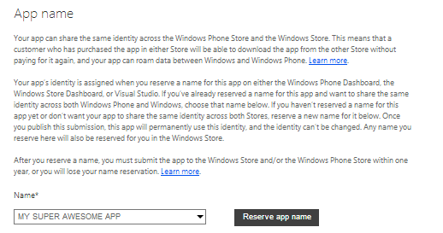
App name reservation for Windows Phone
Notes:
Developers now have the ability to reserve names for new Windows Phone apps for up to 12 months in advance of release (this capability is already available for Windows Store). If you are an existing Windows Phone developer you can continue to update your apps without reserving a name, until you decide to add a Windows Phone 8.1 package. And, once you update to Windows Phone 8.1, your apps may keep the current display name even if the name has been reserved for another app in the Windows Phone Store. Learn more about name reservation.

Slide 22
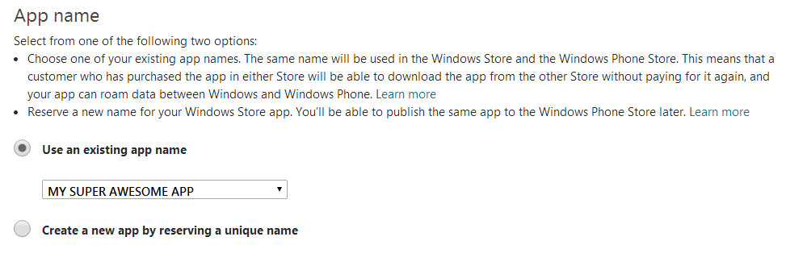
App name reservation for Windows 8.X
Notes:
Reserved names are now able to be used across platforms. Notice that the Windows 8 Store portal can recognize existing reserved names created for Phone apps.

Slide 23
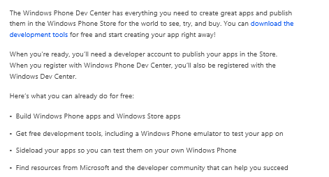
Publish for both with one registration
Notes:
Last November we released unified registration enabling developers to register for one account to submit apps to both the Windows Store and Windows Phone Store. In the next few days with the availability of the Windows Dev Center, we are simplifying that experience by no longer requiring a credit card for identity validation during registration and enabling PayPal as a registration payment and renewal option (in markets where PayPal is currently supported).

Slide 24
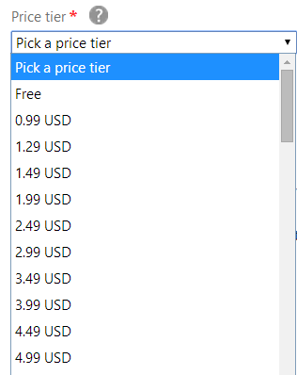
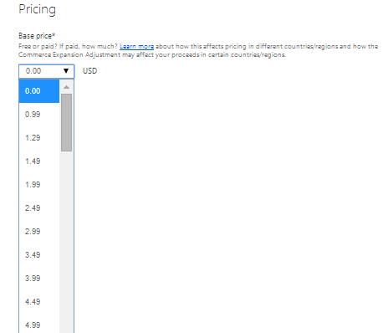
Consolidated Pricing
Notes:
Recently, we rolled out a single set of price tiers across Stores to simplify pricing and support universal Windows apps. This consolidated pricing is applicable for paid apps and in-app purchase and expands Windows developer opportunity with the addition of US$0.99 and $1.29 (USD) price tiers to Windows Store; apps priced in this range represent 55% of Windows Phone transactions today. In addition to consolidation, we also adjusted for local factors including changes in foreign exchange rates, taxes and market-specific pricing options. The new price tiers are live now for all apps and may impact your current app pricing. You’ll want to visit Dev Center to review your app pricing and make any necessary adjustments.
*Left – Windows 8 Store
*Right – Windows Phone Store

Slide 25
Resources
Universal Windows app samples:
http://code.msdn.microsoft.com/windowsapps/Universal-Windows-app-cb3248c3
Build apps that target Windows and Windows Phone 8.1 by using Visual Studio (Windows Runtime apps using C#/VB/C++ and XAML):
http://msdn.microsoft.com/en-us/library/windows/apps/dn609832.aspx#addsupport
Dev Center now open for Windows Phone 8.1 and universal Windows app submissions:
http://blogs.windows.com/windows/b/buildingapps/archive/2014/04/14/dev-center-now-open-for-windows-phone-8-1-and-universal-windows-app-submissions.aspx
Notes:
Finally, if you are looking to learn more to jump start you Universal app development skills, you may wish to take a look at the following resources. The Universal Windows app samples provides dozens of examples across C#, C++, and Javascript. Most common scenarios are covered included some deeply technical examples. Remember if you have not registered to develop for Windows Phone or Windows 8, the store now offers a single point of registration for access into both marketplaces. It’s a great time to develop for the Windows app ecosystem!

